Slide 1
Capstone Project 12 | Power BI Dashboard
PREPARED FOR THE CHICAGO POLICE DEPARTMENT
Chicago Crime Analytics & Operational Resource Allocation
Data-Driven Command Decisions for Patrol Deployment and Risk Prevention (2020–2022)
Objective
Strategic Goal
Core Impact
Synthesize 600,000+ incident records from Chicago’s CLEAR system into an interactive 6-page executive dashboard.
Shift police command staff from reactive patrol reporting to proactive, hourly, and district-level resource deployment.
Pinpointed peak workload drivers, identified high-volume unassigned backlogs, and established district efficiency benchmarks.

Slide 2
STRATEGIC FOUNDATIONS
Project Motivation & Objective Statement
Objective Statement
Core Research Questions:
To clean, model, and transform multi-year Chicago police incident records into an actionable data story that isolates spatial-temporal hotspots, evaluates district clearance performance, and optimizes shift resource allocation for executive command staff.
1
How did total crime volume shift from 2020 to 2022?
2
When does crime peak by hour of day and shift windows?
3
Which police districts serve as primary workload hotspots?
4
What share of incidents lead to an arrest, and how has clearance performance evolved?
Project Motivation
Metropolitan police departments face severe resource constraints and surging call volumes.
Static monthly reports obscure critical intraday spikes, preventing command staff from optimizing shift overlays.
Raw public safety data contains significant quality issues, duplicate categorizations, and non-standardized location definitions that distort high-level decision-making.
5
How common is domestic crime and where is it concentrated?

Slide 3
DATA ARCHITECTURE
Dataset Overview & Data Quality Watch-Outs
Overview & File Structure
1
211,426 × 18
Crime_2020.csv
Incidents in 2020: date, type, location, arrest, domestic, beat, coordinates
Data quality watch-outs
Location_Types is laid out sideways under a title row; transpose it, and one description is just "0"
IUCR codes need leading zeros kept (0281); "CRIM SEXUAL ASSAULT" and "CRIMINAL SEXUAL ASSAULT" are the same category renamed
10K incidents lack coordinates, 2 fall outside Chicago, and 26 sit in district 31
2022 stops at 7 Dec; compare years per day, not by raw totals
Districts, wards and community areas are numbers only, with no names
2
207,430 × 18
Crime_2021.csv
Incidents in 2021 (same columns)
3
220,550 × 18
Crime_2022.csv
Incidents from 1 Jan to 7 Dec 2022 (partial year)
4
473 × 5
Crime_Types.csv
Primary type, description, IUCR code and FBI code
5
177 IDs
Location_Types.csv
Location description (street, apartment, residence…)

Slide 4
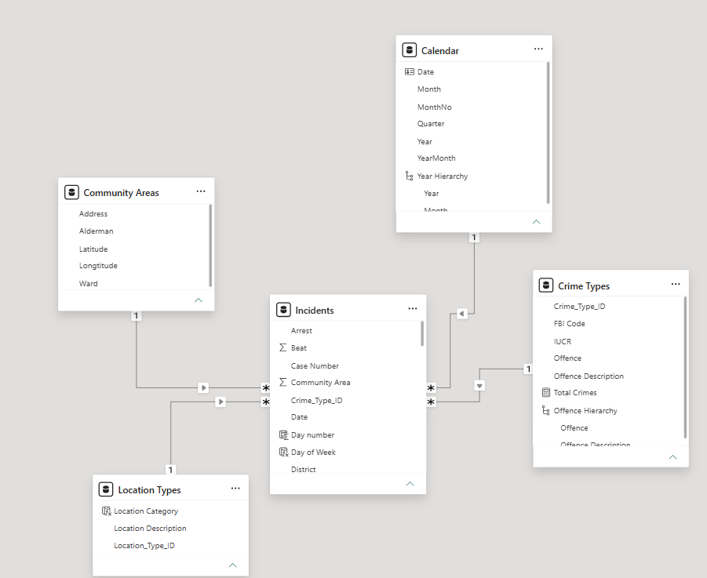
DATA ARCHITECTURE
Primary Dataset
Primary Dataset Summary
Data Model / Star Schema
The dataset originates from the Chicago Police Department’s Citizen Law Enforcement Analysis and Reporting (CLEAR) system, recording reported criminal incidents across Chicago from 2020 through 2022.
Key attributes include temporal timestamps (Date, Hour, Month), spatial designations (Block, District, Ward, Beat, Coordinates), classification fields (Primary Type, Description, Location Description), and operational flags (Arrest, Domestic)
The raw dataset contains 639,406 records. After excluding 10,035 rows missing coordinates and 25 District 31 outlier rows, the final cleaned model contains 629,345 records across 22 operational police districts and 50 municipal wards.

Slide 5
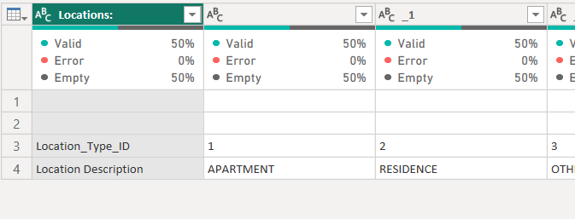
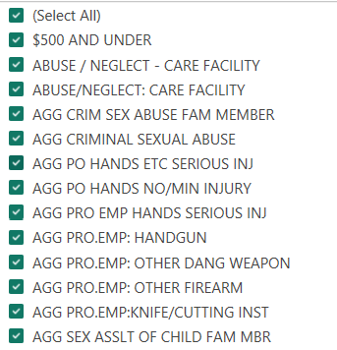
DATA ENGINEERING & ETL
Reference Table Cleaning
location_type.csv
crimes_types.csv
Empty Rows & Structure: Filtered out empty rows; transposed structural layout from horizontal matrix to vertical tabular format.
Header & Case Normalization: Promoted first row to headers; applied Capitalized Each Word transformation across all text columns.
Null/Garbage Removal: Removed 3 rows containing explicit Null values and unclassifiable Other entries.
Delimiter & Spacing Standardization: Standardized all slashes (/) and dashes (-) to ensure uniform spacing before and after delimiters (e.g., changing Parking Lot/Garage to Parking Lot / Garage).
Capitalization: Converted Primary Type and Description text fields from uppercase to Sentence/Capitalized casing for clean visualization labels.
Separator Normalization: Replaced hyphen separators (-) with colons (:).
Spacing Rules: Enforced standard spacing surrounding all colons (e.g., transforming THEFT - OVER $500 to Theft : Over $500)

Slide 6
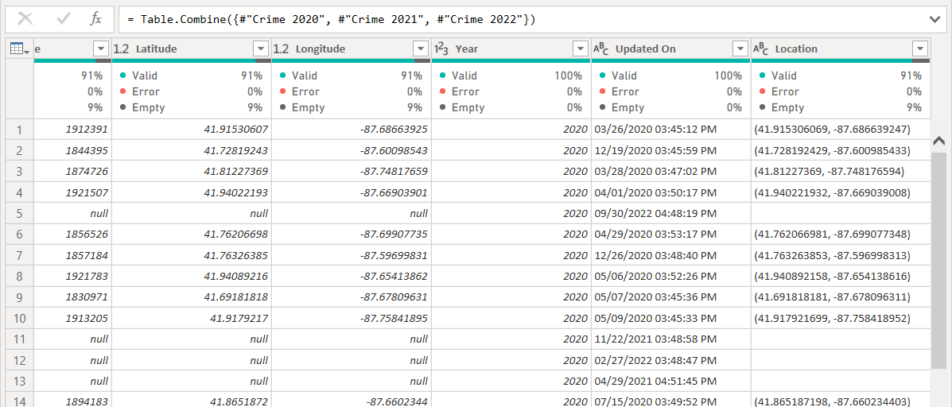

DATA ENGINEERING & ETL
Fact Table Refinement
Crimes 2020 - 2022.csv
Column Pruning: Removed redundant Location
(raw lat/long tuple string) and system metadata column Updated On to reduce file footprint and optimize DAX storage.
Table Renaming: Appended multi-year CSV files and renamed the unified query to Incidents.
Null Record Handling: Excluded 10,035 null rows missing critical spatial/temporal attributes.
Locale & Datatype Fixes: Converted Date/Time text strings into standard US Date/Time format (MM/DD/YYYY HH:MM:SS AM/PM).
Outlier Removal: Identified and dropped 25 erroneous rows assigned to District 31 (a non-existent CPD district).
Daily Rate DAX Equation

Slide 7
DATA ENGINEERING & ETL
Offence Variant Spelling Standardization
Objective
Raw CLEAR descriptions contained inconsistent abbreviations, shorthand codes, and variant spellings (e.g., Crim Sexual Assault vs. Criminal Sexual Assault), creating artificial duplication in reporting.
Standardize variant type on Crime_Types Description:
  Agg., Agg → Agg
  Po, P.O. → Police Officer
  Pro.Emp, Pro Emp → Protected Employee
  Sex Asslt → Sexual Assault
  Fam Mbr → Family Member
  Attn → Attempt
  Cut Instr → Cutting Instrument
  W- → With
  Manu → Manufacture
  Poss, Possess → Possession
  Prop → Property
  Sup → Supported
  Veh → Vehicle
  Vio, Violate → Violation
Cleaning Action
Power Query Table.ReplaceValue transformations were executed to standardize text strings across all offense descriptions:

Slide 8

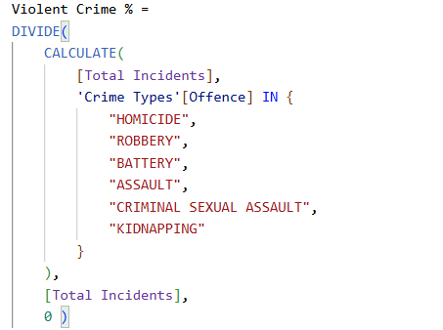
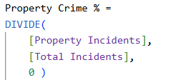

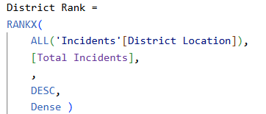
DAX MEASURES
Power BI DAX Measures Architecture
Volume & Daily Average Measures
Offense Categorization Rates (Violent vs. Property)
District Ranking Measure
Arrest Rate % (Clearance Proxy)

Slide 9
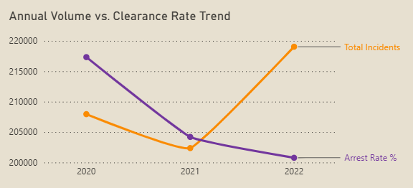
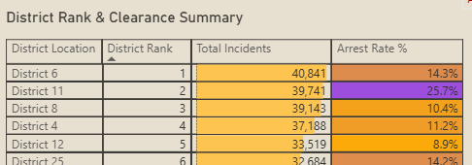
FINDINGS
Executive Findings (Major Insights)
Finding 1
Finding 2
Divergence in Volume vs.
Clearance Performance
Total incidents rose from 202,365 in 2021 to 219,033 in 2022, yet the overall Arrest Rate dropped to 11.2% in 2022 (down from 16.2% in 2020 and 12.3% in 2021; 3-year average: 13.2%)
Extreme Hourly Workload Clustering
Incident density forms a pronounced diurnal trough between 03:00–05:00 AM before surging rapidly to sustain peak pressure across the 16:00–00:00 window (39.5% of total volume). (Note: Raw 00:00 and 12:00 PM spikes reflect default logging timestamps)
Finding 3
Finding 4
High Volume of Incidents Without
an Arrest
Out of 629,345 total recorded incidents, 546,252 resulted in no arrest (86.8%), representing an ongoing investigative workload across property and non-violent crime categories.
District Workload Imbalances
District 6 (40.8K), District 11 (39.7K), and District 8 (39.1K) consistently top the city in total incident volume and workload rank, carrying over 3x the volume of low-density outer districts (e.g., District 20)

Slide 10
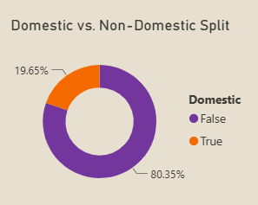
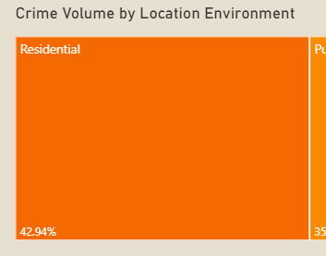
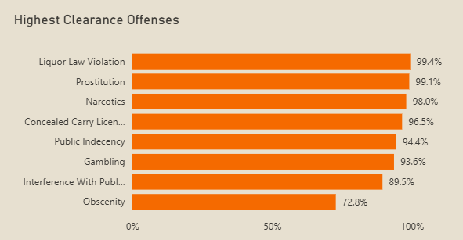
FINDINGS
Secondary & Minor Findings
Finding 5
Finding 6
Finding 7
Domestic Incident Concentration in Residential Premises
Domestic incidents represent 19.65% of total citywide crime, with 42.94% of all crimes occurring within Residential/Apartment premises.
Property Crime Dominance in
High-Volume Areas
Theft (129,424 cases) and Battery (119,960 cases) represent the two largest offense categories, with Theft heavily concentrated in retail/commercial hubs during afternoon hours.
Offense-Specific Clearance Asymmetry
High clearance rates exist for narcotics (>95%) and prostitution due to direct on-scene police action, whereas property thefts and criminal damage exhibit sub-10% clearance rates.

Slide 11
FINDINGS
Operational Recommendations for Command Staff
Shift Schedule Overlays
(15:00 - 23:00 Focus):
Transition tactical units away from early morning shifts (03:00–07:00) to create an overlapping "Power Shift" covering 16:00 to 00:00, matching the peak incident ramp-up.
248,556
District Resource Rebalancing:
Reallocate roving patrol units from District 20 (lowest volume rank) to District 6 (40.8K), District 11 (39.7K), and District 8 (39.1K) during Friday and Saturday evening hours.
39.5% of Citywide Volume
Peak Incident Window (16:00 – 00:00)
District 6
(#1 Rank Volume)
High Workload vs. District 20
Premise-Specific Patrol Focus:
Increase visible foot and bike patrols in commercial corridors during 12:00–18:00 to mitigate retail theft, freeing up motorized units for violent crime response.
Domestic Incident Rapid Response:
Establish specialized domestic intervention teams tied to high-density residential wards to address the 19.65% domestic crime baseline.
Target Districts for Tactical Patrol Deployment
19.65%
Domestic Incident Baseline
Triggers Dedicated Rapid Response Protocol

Slide 12
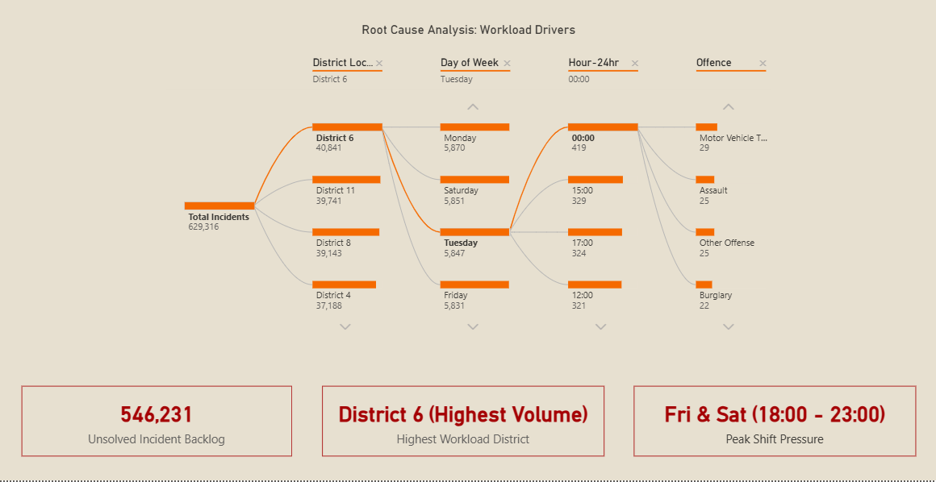
DASHBOARD FEATURE
Workload Driver Breakdown & KPI Summary
546,252
Fri & Sat
(18:00 - 23:00)
District 6
(Highest Volume)
Incidents Without an Arrest
Peak Shift Pressure Window
Primary Geographic Workload Focus

Slide 13
SUMMARY
Technical Implementation & Dashboard Enhancements
Data Architecture & ETL Foundations
Advanced DAX Engineering & Visual Logic
Multi-Table Relational Model: Built a clean Star Schema data model connecting normalized fact tables (Incidents) and dimension lookup tables (location_type, crime_types).
Rigorous Data Hygiene: Filtered and cleaned 600k+ records by standardizing 14+ offense categories, removing invalid geospatial records (e.g., District 31), and handling null values across premise categories.
Formatted KPI Cards: Custom DAX (FORMAT, TOPN) displaying formatted labels like 12:00 PM (Peak Hour).
Dynamic Performance DAX: Built RANKX, Arrest Rate %, and Domestic Rate % measures that adapt to slicers.
Shift Window Analytics: Isolated 16:00–24:00 Power Shift and Fri/Sat evening surge volumes
Executive UX & Visual Analytics
Interactive Root Cause Analysis: Decomposition Tree for dynamic volume drill-downs.
Searchable Multi-Select Slicers: Instant filtering across high-cardinality location and crime fields.
Insight-Driven Titles: Decision-focused visual headers replacing default column names.
Notes:
To wrap up, this project demonstrates how raw public safety data can be cleaned and transformed into clear, actionable spatial-temporal insights. Thank you for listening, and I’m happy to take any questions!

Slide 14
Thank you!

